Slide 1

Capstone Project - IV
UNSUPERVISED LEARNING
Topic Modelling on News Articles
Submitted By :
Aman Mishra

Slide 2


Contents
Overview
Data Understanding
Data Wrangling
Exploratory Data Analysis (EDA)
Feature Engineering
Model Implementation
Model Comparison
Model Validation
Summary & Conclusions

Slide 3
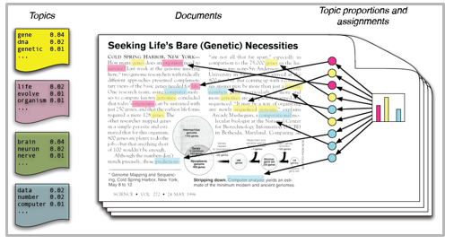
Overview
What is Topic Modelling ?
Topic – A collection of dominant keywords that are typical representatives.
i.e. Just by looking at the keywords , we can identify what the topic is all about.
Dataset :
A BBC news articles dataset with over 2200 files is presented , which contains text documents with hidden topics /themes .
The goal is to identify the topics such as ‘Business, Politics, Technology, Sports, Entertainment ‘ from each major segment in the news articles
Clustering Algorithms are to be used for carrying out the task

Slide 4
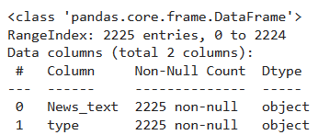
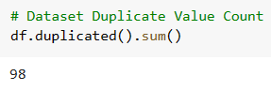

Data Understanding
Features mentioned in the dataset :
News_text : News articles with mutiple documents
Type : topics/ themes of news articles
The dataset contains following informations w.r.t news articles which will help in further processing of data
Duplicate values :
Dataset contains 2225 columns with zero null values.
Dataset contains 98 duplicate rows

Slide 5
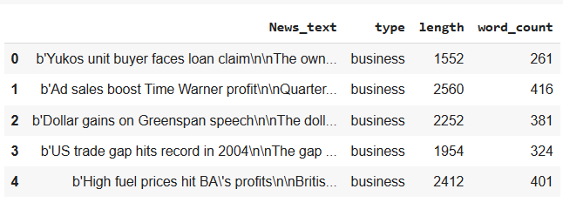
Data Wrangling
Data Overview:
Length of each article /document and word count of document is calculated

Slide 6
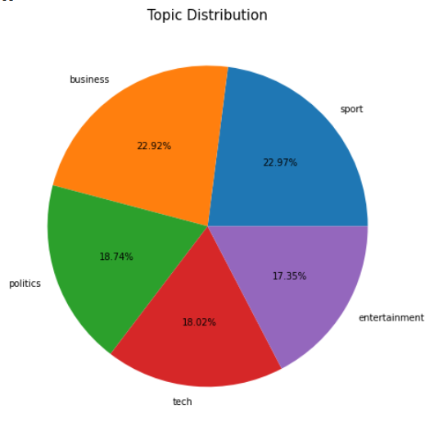
EDA
Does topic distribution affect model performance ?
Sports and Business themes accumultes the majority portion of the news
Followed by Politics , Tech & Entertainment.
This can also indicate that some of the algorithm may be more biased towards the one of the topics containing majority of texts.

Slide 7
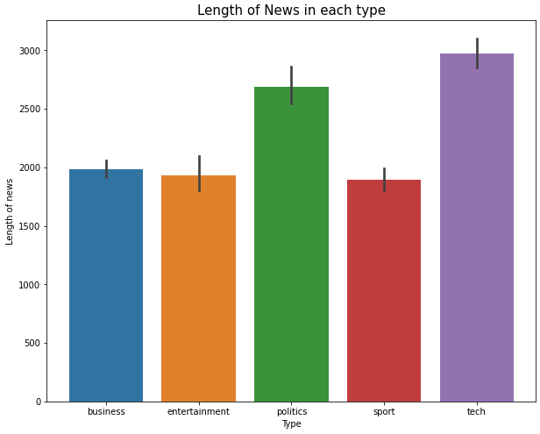

EDA
Length of news
Word_count of news
Length of news for the topic ‘Tech’ is maximum about 3000 followed by ‘Politics’
Same is the result for word_count
Length or word_count dosen’t signify more bias towards these topics , as they don’t accumulate the majority of the articles.

Slide 8
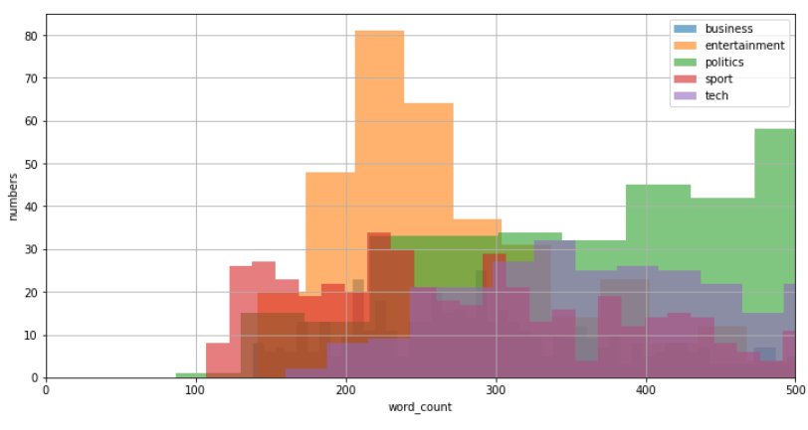
EDA
Can Word_count help distinguish Topics ?
Word_count of all topics is dense between 200-350 hence, cannot distinguish between topics based on word_count
Same will be the result for length of news.

Slide 9
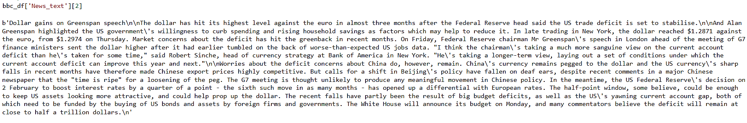
First Look of Data
How does the data look like ?
Dataset contains various characteristics which need to be cleaned , to focus on just the words that may prove to be important for model implementation

Slide 10
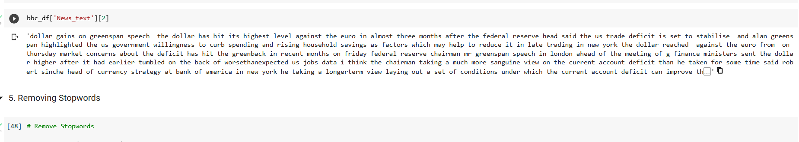
Feature Engineering
Irrelevant features in the data
Lower casing
Removing url’s
Removing non-words
Removing punctuatioins
Removing digits
Is clean data obtained ?

Slide 11
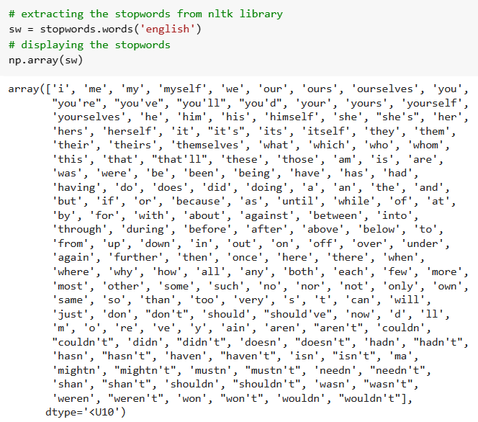
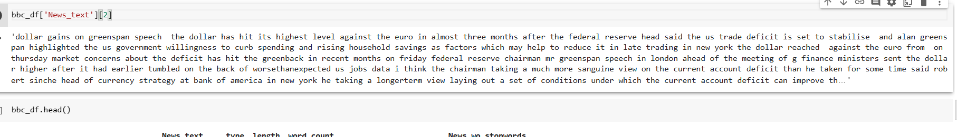
Removing Stopwoords
Stopwords :
Dataset after removing stopwords

Slide 12
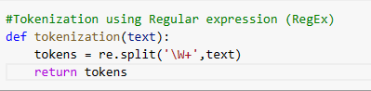
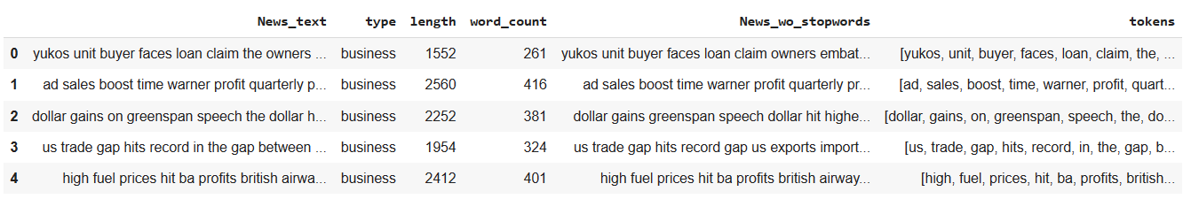
Tokenization
Tokenization using Regular Expressions (RegEx)
Regular expression is a special character sequence that helps to match or find strings or set of strings using that sequence of pattern
‘\W+’ -> matches any word character (alphanumeric) until any other character is encountered.

Slide 13
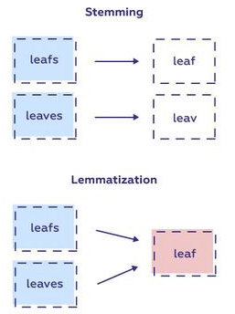
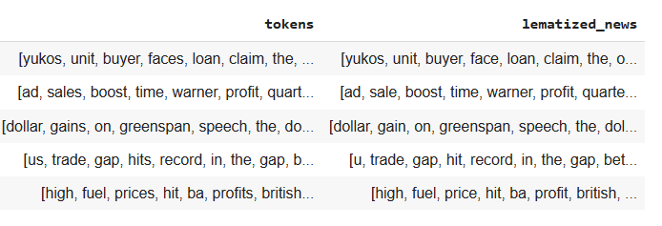
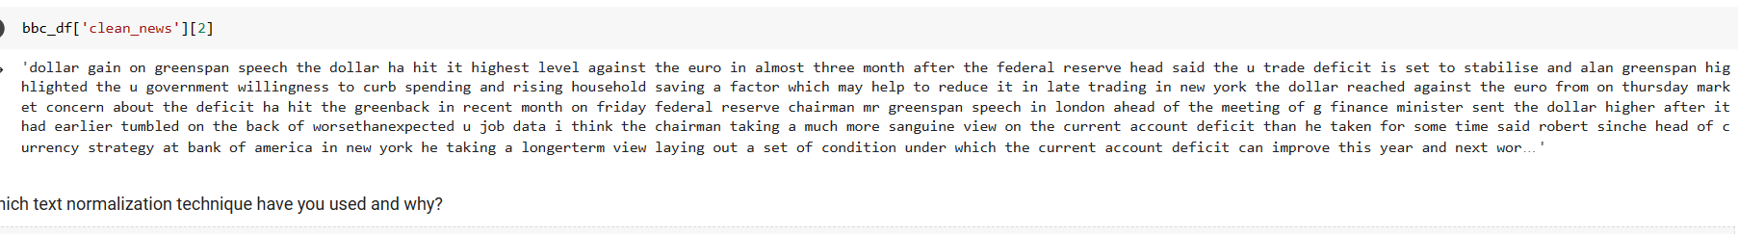
Text Normalization
WordNet Lemmatization
WordNet Lemmatization technique was used for normalization, since it considers the meaning & context of the words and connects it to root word
News after normalization

Slide 14
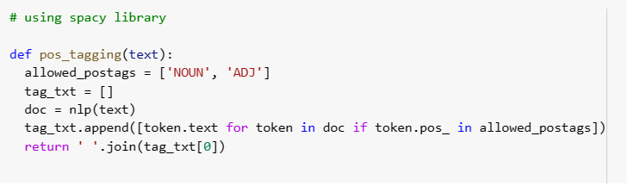
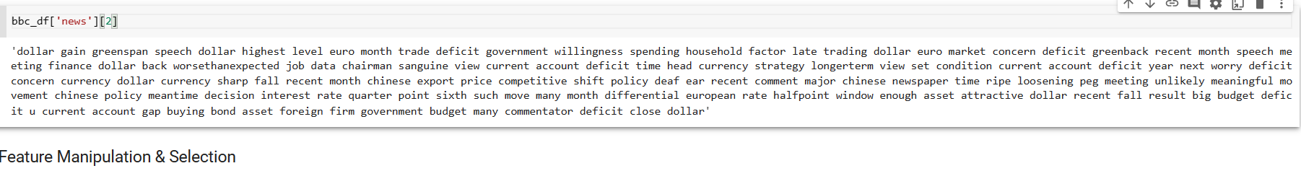
Parts of Speech (POS) tagging
Using Spacy library
Words belonging to various parts of speech form a sentence , knowing the parts of speech of words in a sentence is important for understanding the meaning behind a sentence/word.
Parts-of-Speech (POS) tagging is the process of assigning different labels (Parts of speech ) to a word in a sentence.
Using POS_tagging , we filter the sentence with a specific and relevant Parts of speech ,for better model interpretation.

Slide 15
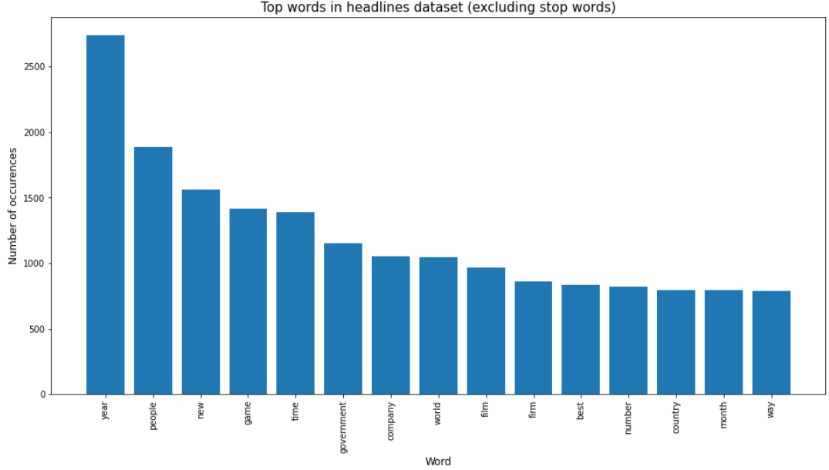
Feature Manipulation
Top words in headlines

Slide 16
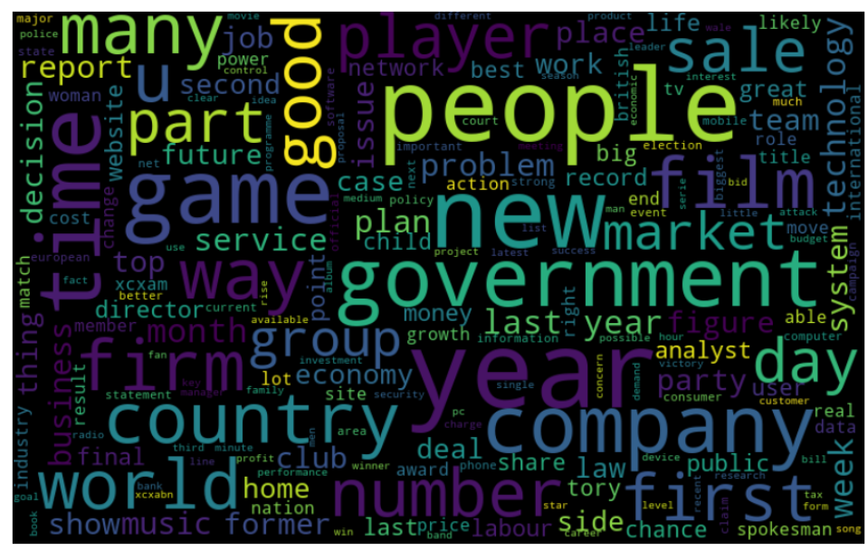
Word Cloud
Word Cloud of the final news obtained after feature engineering
Most prominent words in the news :
People
New
Market
Government
Game
Service
Country
Company
Year
Good
World
Sale
Film etc…

Slide 17
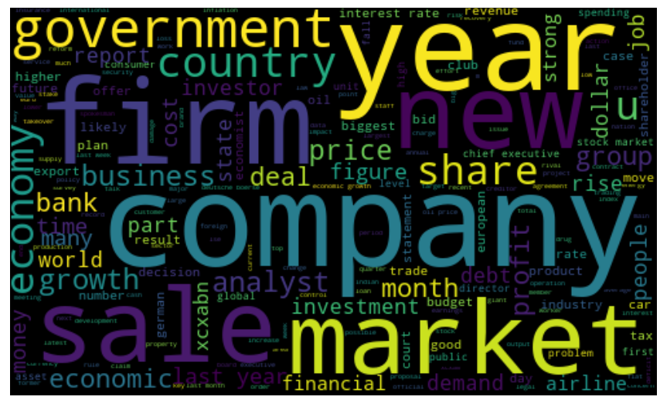
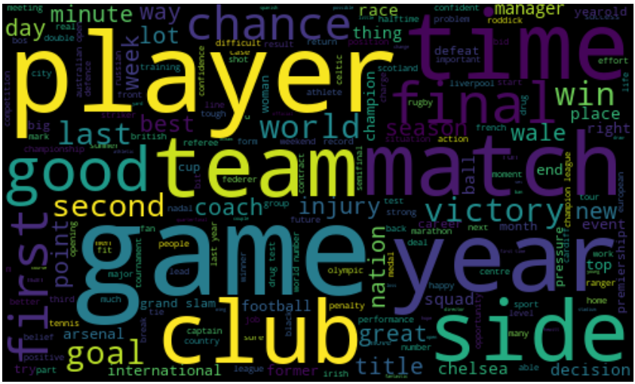
Word Cloud
Business
Sport
Most prominent words in Business:
Company
Year
Firm
Sale
Market
Government
Investment
Share
Price etc…
Most prominent words in Sport:
Player
Team
Match
Club
Goal
Final
Time
Win
Victory etc…

Slide 18
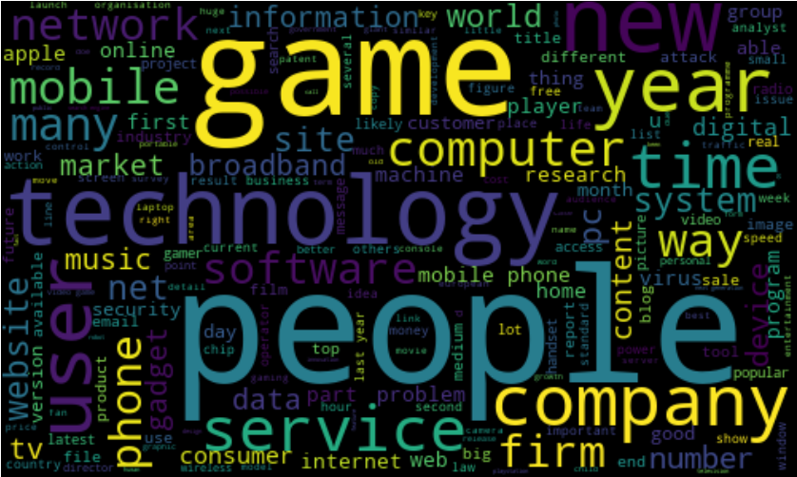
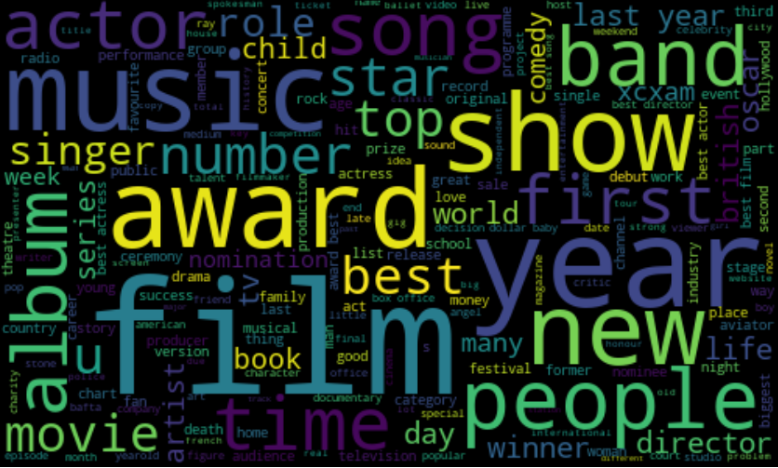
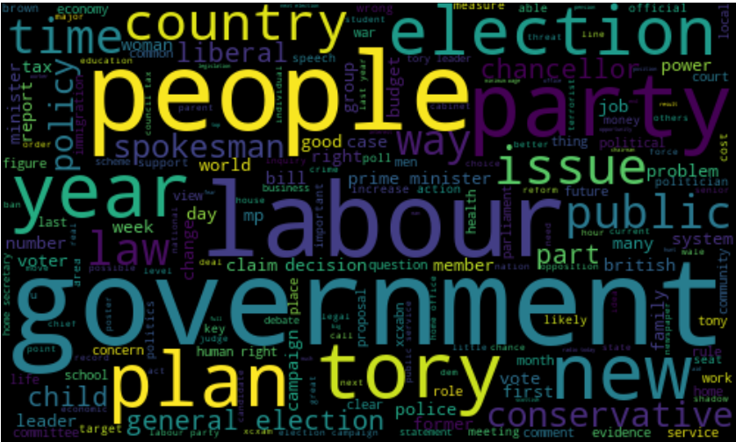
Word Cloud
Tech
Entertainment
Politics
Most prominent words in Tech:
Technology
People
Time
Service
Game
Phone
User
Mobile
Firm
Computer etc…
Most prominent words in Entertainment:
Award
Music
Star
Show
Film
Movie
Album
Singer
Director
People etc…
Most prominent words in Politics:
Government
Labour
Year
People
Plan
Party
Election
Issue
Policy
Law
Member etc…

Slide 19
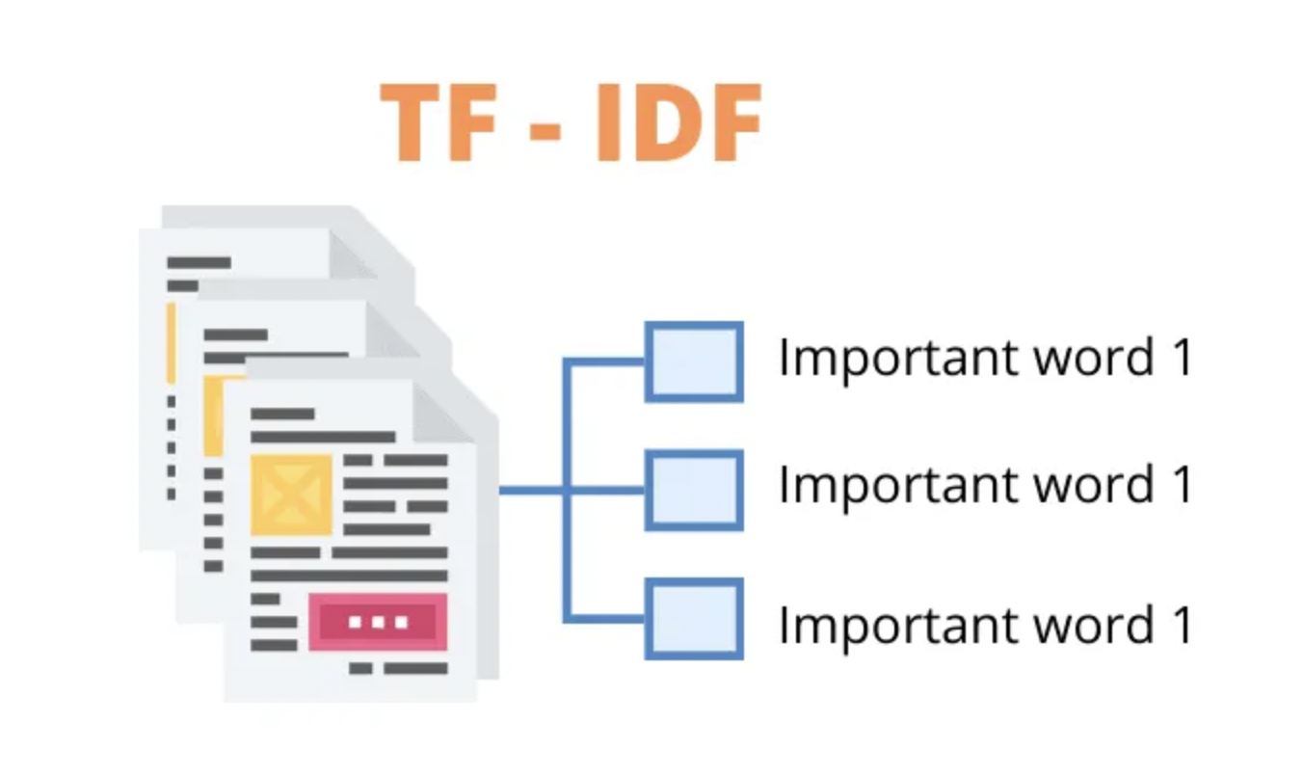
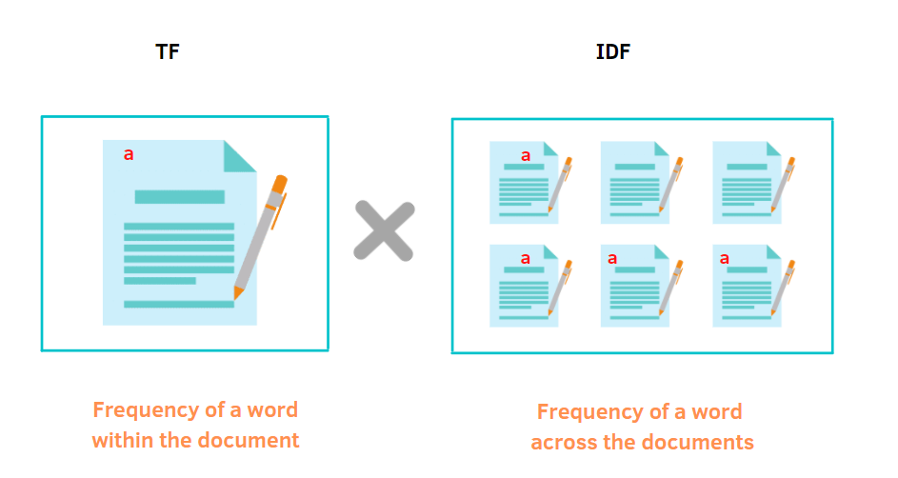
Text Vectorization
Term Frequency-Inverse Document Frequency (TF-IDF)
TF-IDF counts the occurrence of each word in a document & weights the importance of each word and calculates a score for that document .
It calculates how importance a word is to a document in a document corpus.
Term Frequency (TF) –
Calculates frequency of word within a document.
Inverse Document Frequency (IDF) –
Calculates frequency of word across the documents.
TF-IDF technique is used because CountVectorizer or other techniques only counts how many times a word appears in a document.
Tf-IDF takes into account not only how many times a word appears in a document but also how important the word is to the whole document.

Slide 20
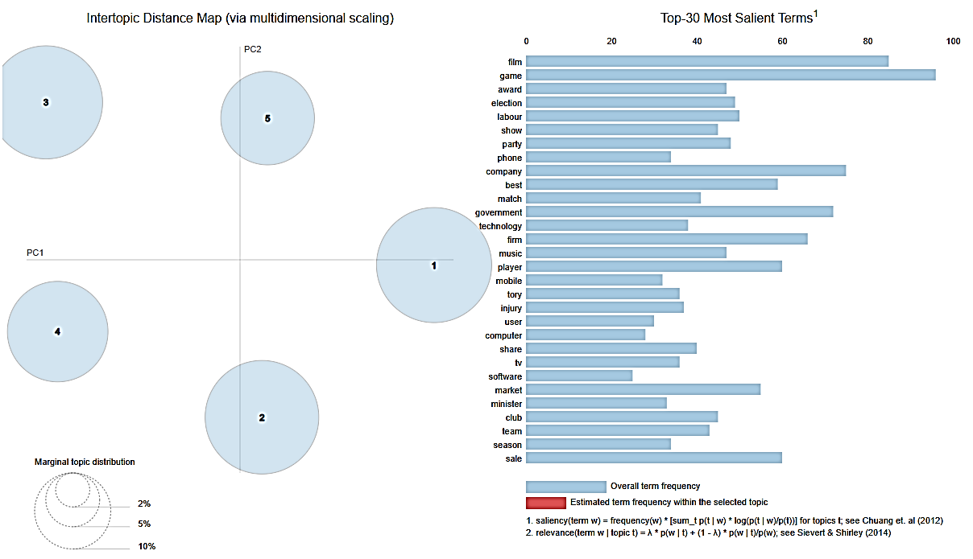
Model Implementation
Latent Dirichlet Allocation (LDA)

Slide 21
Model Implementation
LDA Summary :
LDA is a satistical generative model, which builds a probability of topic per document model & probability of words per topic model, know as Dirichlet Distribution.
How it works ?
1. Assuming a particular number of topics ,present in the document .
2. Randomly assign each of the words in the document to one of these topics.
3. Go through each word and assigned topic in each document :
- How often does the topic occur in the document ?
- How often does the word appear in that tiopic ?
In the dataset given, LDA corectly describes most of the topics we predicted :
1. Business
2. Sports
3. Politics
4. Technology
5. Entertainment

Slide 22
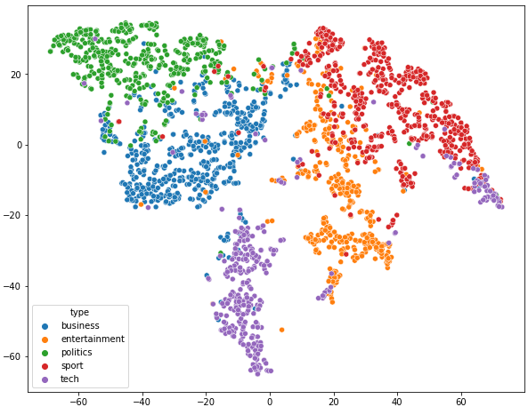
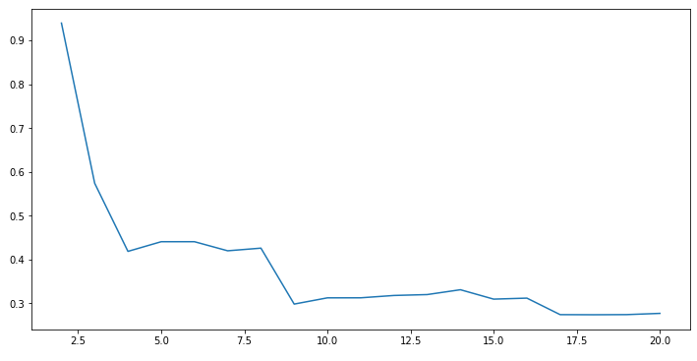
Model Implementation
Latent Semantic Analysis (LSA)
TSNE pplot
1. Using Count-Vectorizer :
Silhoutte Score
Silhouette score is quite low , which indicates that either the clusters are not linearly separable or there is a considerable amount of overlap among them.
Tech related news articles are wide spread , whereas other news articles are clustered nicely.
While LSA has done a good job of segregating news articles into different topics. Some of the clusters are still overlapping

Slide 23
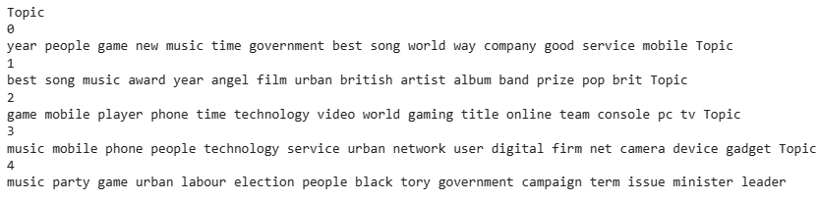
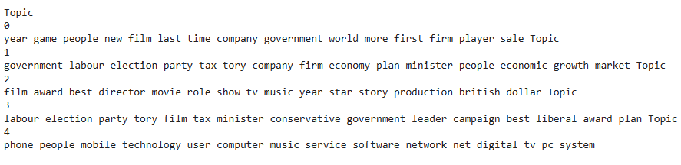
Model Implementation
Latent Semantic Analysis (LSA)
1. Using Count-Vectorizer :
Due to cluster overlapping, distribution is not precise .
Topics are focused only on particular words , which are repeated frequently.
Only Topic 1, 2, 4 are identifiable as Entertainment, Tech, Politics
Topics Sport and Business are not identified correctly.
Same result as Count Vectorizer only 3 of 5 topics are identified correctly.
Topic 1: Politics , Topics 2: Entertainment , Topic 4: Tech.
Sports and Business topics are identified incorrectly.
Only difference is that distribution of words in TF-IDF is better than Countvectorizer
2. Using TF-IDF Vectorization

Slide 24
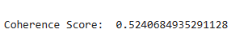
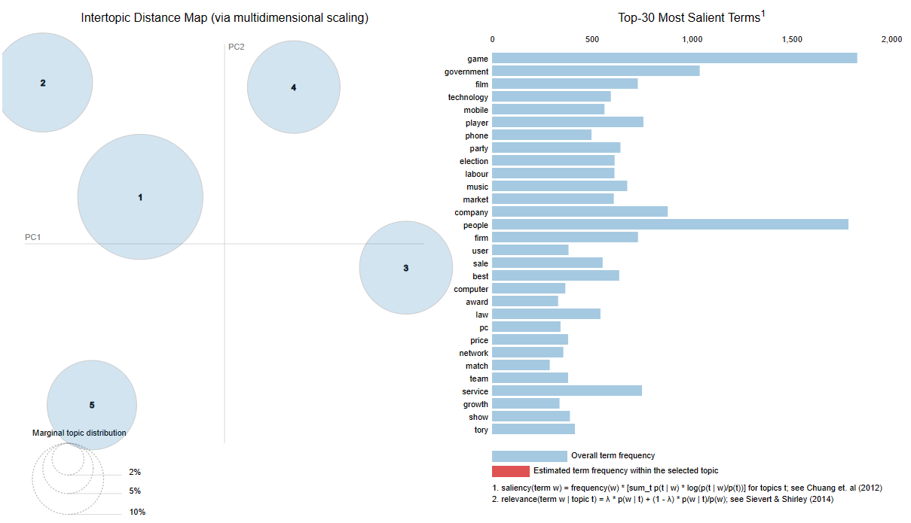
Model Comparison Summary
(LDA) using gensim library

Slide 25
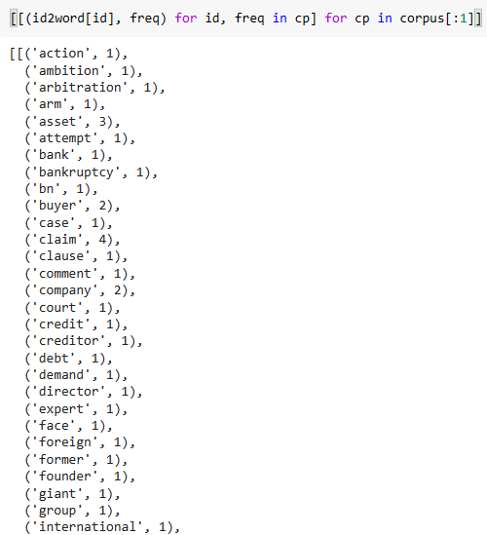
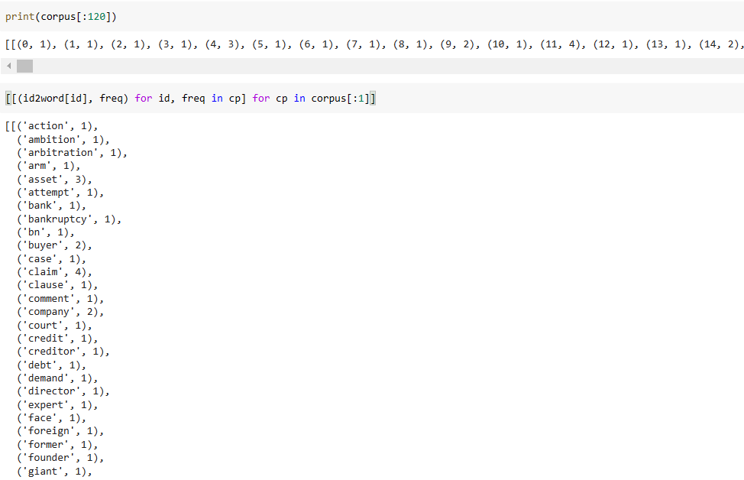
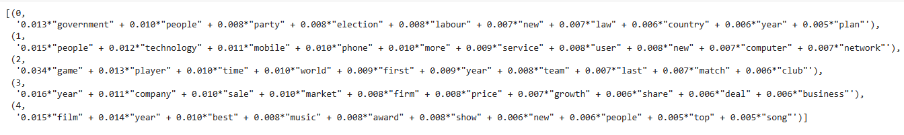
Model Comparison Summary
(LDA) using gensim library
Gensim library ?
A library used in unsupervised topic modelling and NLP to extract semantic topics from the documents.
It creates a unique id for each word in the document , which is used as an input to LDA model
After implentation of algorithm, we get 5 different topics , where each topic is a combination of keywords and each keyword contributes a certain weightage to the topic, which reflect how important a keyword is to the topic

Slide 26
Conclusion
Overall 3 different algorithms were used for topic modelling on news articles.
LDA provided considerable result , with distinct topics as expected.
LSA with TF-IDF & CountVectorizer did not produce good result with predicting only 3 of 5 topics correctly.
LDA using gensim library provided the best result with a considerable coherence score of 0.52
Topics represented in LDA were adjacent, with hidden topics and relationship between words and documents were found with multiple probability distribution

